Slide 1
Amazon Home Services Introducing AsapTutor
Presenter: Charles Ding
Notes:
Hello everyone, thanks giving me the opportunity to be able to pitch AsapTutor to you guys. My name is Charles and I’ll dive right right in!

Slide 2



What is AsapTutor?
Scalable and Extensible Academia Marketplace
Appointment
Real-Time
Notes:
AsapTutor is a scalable and extensible platform where users go to buy and sell academic services. It combines the traditional scheduling based system like the current amazon home services with that of a more real time scheduling system like that of Uber.

Slide 3









AsapTutor Cutting Edge Technologies
Amazon EC2 Instance Running NodeJS Server
AWS CloudFront and AWS Route 53 – Web Hosting
AWS S3 – Chatting Storage
SendGrid – Email Notifications
Twillio – Mobile Notifications
Braintree – Secure Payment Integration
Firebase – Real-time Database Management
Notes:
We used some of the most reliable and scalable cutting edge technologies on the marketplace today.
We used only the most reliable and scalable cutting edge technologies for this prototype. As you can see, we have aws, nodejs, firebase, and so on.

Slide 4
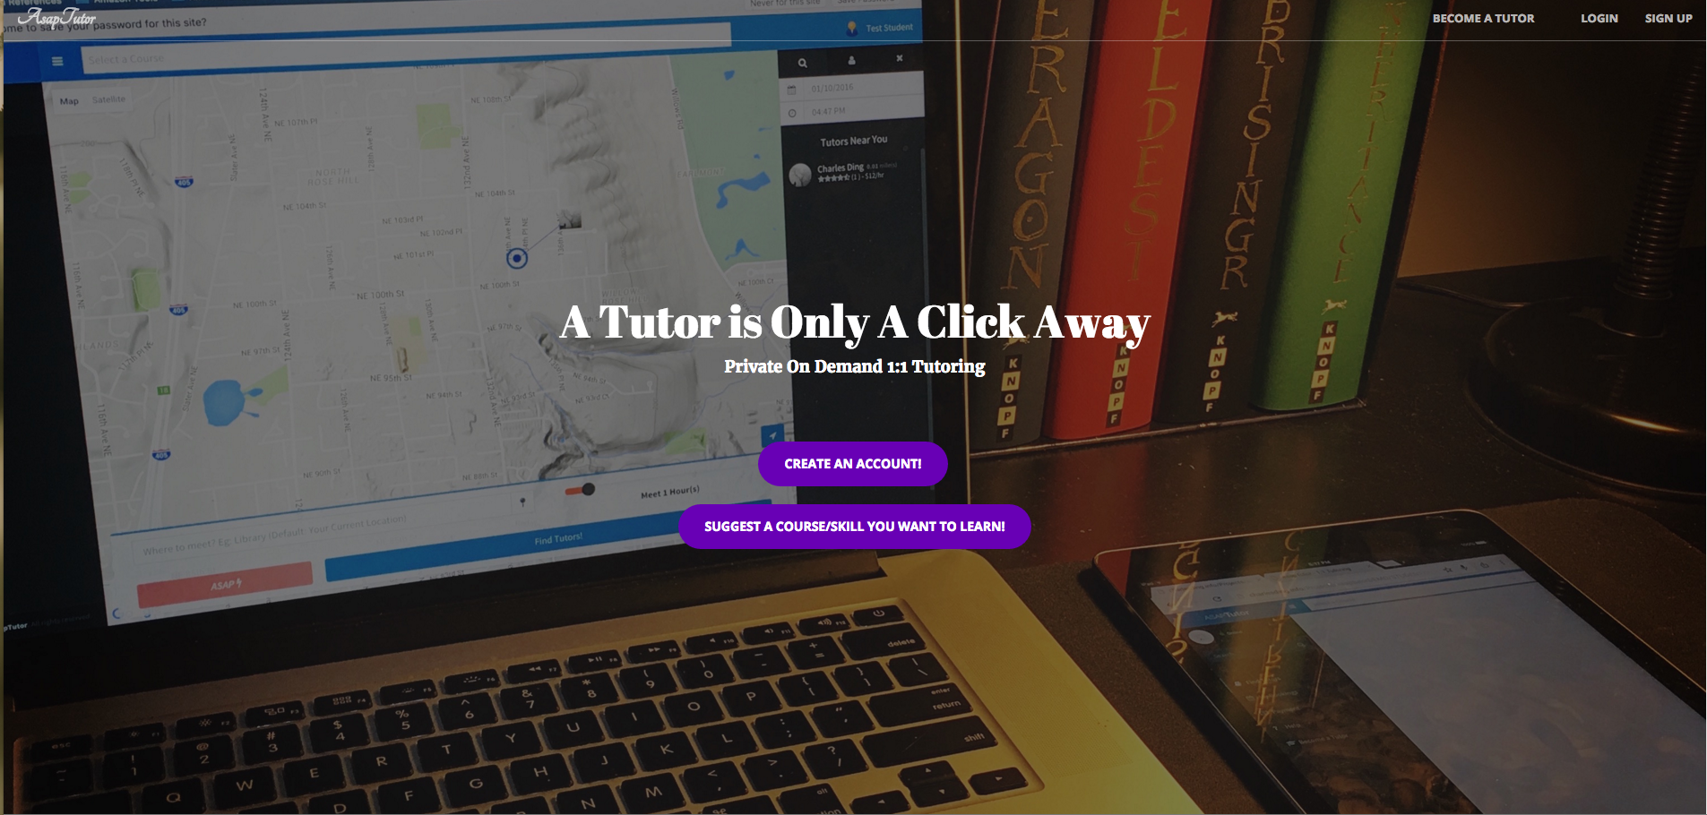
Academic Platform DEMO
Student Perspective: http://asaptutor.us/homePage.html
Tutor Perspective: http://asaptutor.us/tutor.html
Notes:
I’ll go ahead and dive into the demo! It’s a prototype that’s focused on the Academic tutoring market.

Slide 5


Extensibility
Notes:
For now, we focus on Academics, but this platform can be easily extended to any type of service.

Slide 6
Major Features Overview – Questions?
Real-time tracking and real-time visual cues
Real-time status updates/notifications for Mobile and Web
Flexible Scheduling
Chatting Functionality
Credit-Card and PayPal Payment Processing
User Rating
Emergency “ASAP” Button
Notes:
To recap, these are the major feature that asaptutor platform provides Thanks for listening. I’ll go ahead and open the floor to questions.

Slide 7



